Slide 1

CTIS 365
APPLIED DATA ANALYSIS
Dr. Seyid Amjad Ali
syedali@bilkent.edu.tr
C202, 290 5335

Slide 2
T-STATISTIC
Limitations of using z-score
Need to know σ, which is often not known.
When σ is not known, we use the t-statistic rather than a z-score

Slide 3
T-STATISTIC
Instead of using variability for population, we use the sample variability as an unbiased estimate.
Let’s recall the formulas for sample variability and standard deviation:
Using the sample statistics, we can estimate standard error.

Slide 4
T-STATISTIC
Standard error =
Estimated standard error =
s_{M} provides an estimate of the standard distance between a sample mean and the population mean.

Slide 5
T-STATISTIC
THE t STATISTIC
The t statistic is used to test hypotheses about an unknown population mean when the population standard deviation is unknown.

Slide 6
T-STATISTIC
Degrees of freedom and t statistic
df describes the number of scores in a sample that are free to vary.
df = n – 1
Because t-statistic is calculated by using sample variance, each t-statistic is related to a df.

Slide 7
T-STATISTIC
THE t DISTRIBUTION
When the population is normally distributed or when sample size (n) is large, the distribution of z-scores computed from sample means is normal.
When the population is normally distributed or when sample size (n) is large, the distribution of t-statistics is t-distribution with the df (n – 1).

Slide 8
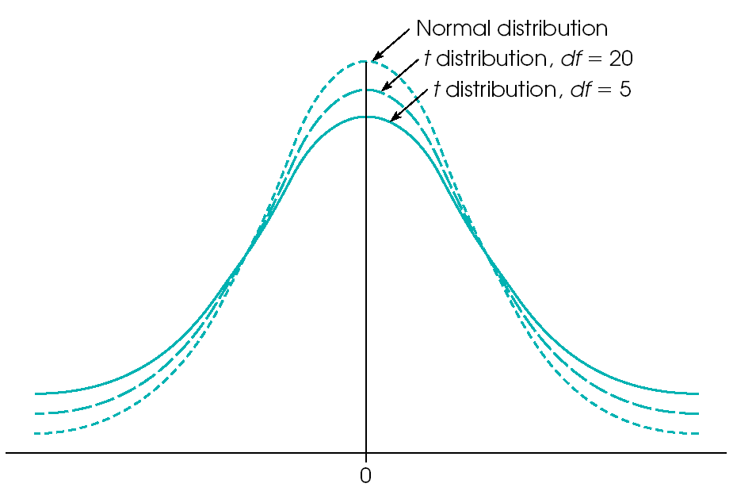
T-STATISTIC
THE t DISTRIBUTIONS
The exact shape of t distribution changes with df.
t distributions are also bell-shaped and symmetrical and have a mean of zero.
As df gets larger, t distribution gets closer to normal distribution.

Slide 9
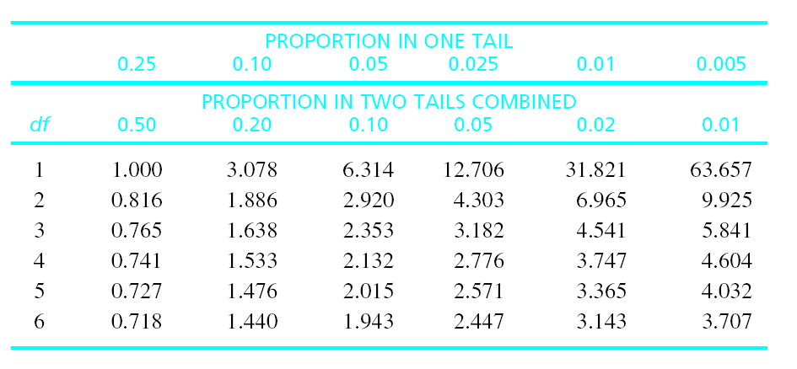
T-STATISTIC
THE t DISTRIBUTION TABLE
See Appendix B.2 (page 651)

Slide 10
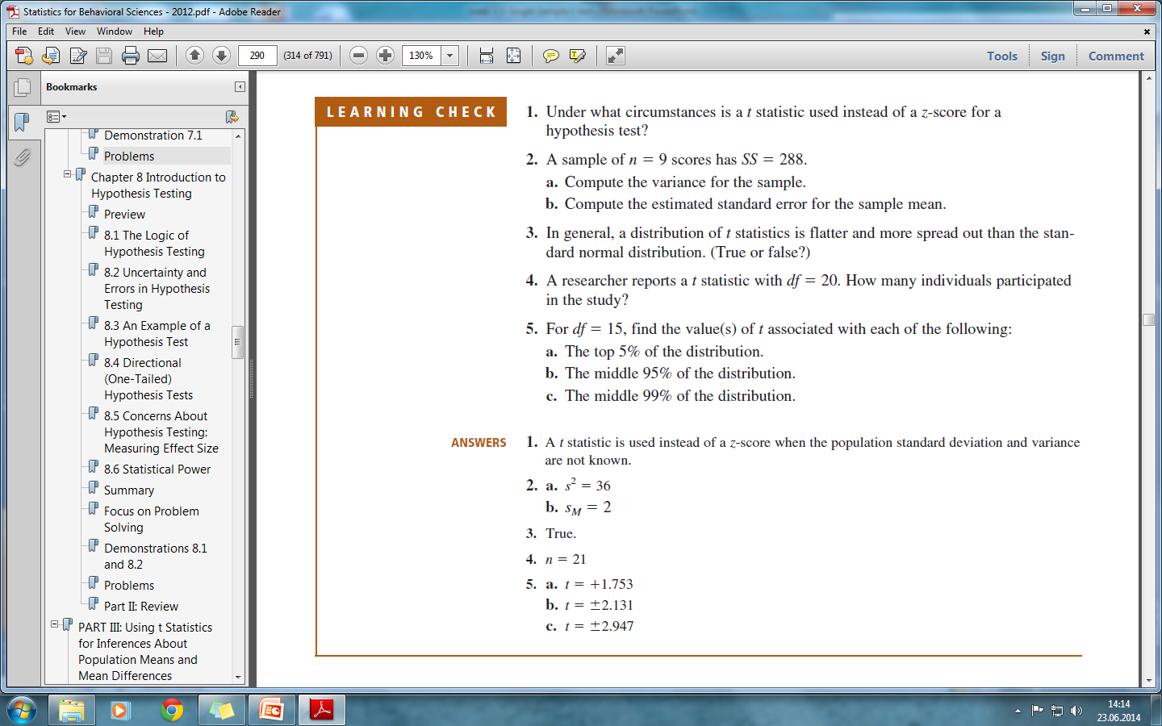

Slide 11
Example
Web page users prefer to look at attractive GUI compared to less attractive faces (Albayrak, 2000). In the study, participants from 18 to 25 years old were shown two different GUI of web pages. Previously, a group of adults had rated one of the GUI as significantly more attractive than the other. The participants were positioned in front of a screen. The pair of GUI remained on the screen until the participant accumulated a total of 20 seconds of looking at one or the other. The number of seconds looking at the attractive GUI was recorded for each participant. Suppose that the study used a sample of n = 9 participant and the data produced an average of M =13 seconds for the attractive GUI with SS = 72. Note that all of the available information comes from the sample. Specifically, we do not know the population mean or the population standard deviation.

Slide 12
T-STATISTIC
HYPOTHESIS TESTING WITH THE t STATISTIC
STEP 1. State the hypotheses
STEP 2. Set the criteria for a decision
STEP 3. Collect data and compute test statistic
STEP 4. Make a decision

Slide 13
T-STATISTIC
STEP 1: State the hypotheses
The null hypothesis H₀: μ_{attractive GUI} = 10
The alternative hypothesis H₁: μ _{attractive GUI} ≠ 10
ᾳ = 0.05 for two tails

Slide 14
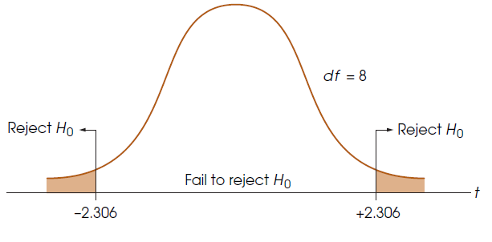
T-STATISTIC
STEP 2: Set the criteria for the decision
We will use t-test rather than z, because σ is unknown.
df = n – 1 = 9 – 1 = 8

Slide 15
T-STATISTIC
STEP 3: Collect data and compute test statistic
Sample data: M = 13 and SS = 72

Slide 16
T-STATISTIC
STEP 3: Collect data and compute test statistic
Sample data: M = 13 and SS = 72

Slide 17
T-STATISTIC
STEP 4: Make a decision
The calculated t statistic (3.0) is greater than the critical t value (2.306). Thus, we reject the null hypothesis and conclude that there is a tendency for the web users to spend more time looking at the attractive GUI.

Slide 18
T-STATISTIC
HYPOTHESIS TESTING WITH THE t STATISTIC
Example 1. The average test score of 5th graders is 86. A researcher claims that the average test score of children from low SES families is not different from that of the population. To test whether this claim is true, a sample of 16 children from low SES families was selected and their test scores were secured.

Slide 19
T-STATISTIC
HYPOTHESIS TESTING WITH THE t STATISTIC
STEP 1. State the hypotheses
STEP 2. Set the criteria for a decision
STEP 3. Collect data and compute test statistic
STEP 4. Make a decision

Slide 20
T-STATISTIC
STEP 1: State the hypotheses
The null hypothesis H₀: μ_{low SES} = 86
The alternative hypothesis H₁: μ_{low SES} ≠ 86

Slide 21
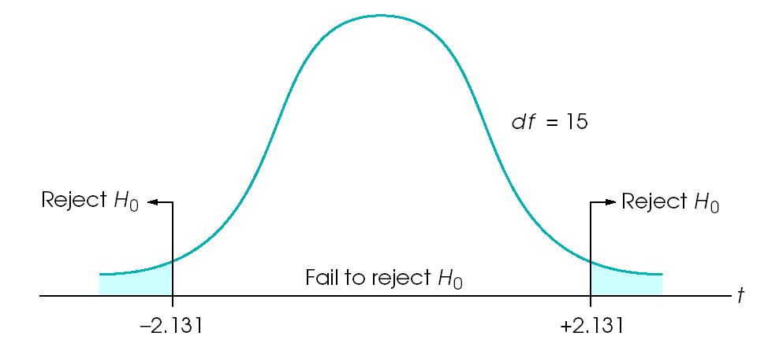
T-STATISTIC
STEP 2: Set the criteria for the decision
We will use t-test rather than z, because σ is unknown.
df = n – 1 = 16 – 1 = 15

Slide 22
T-STATISTIC
STEP 3: Collect data and compute test statistic
Sample data: M = 84 and SS = 240

Slide 23
T-STATISTIC
STEP 3: Collect data and compute test statistic
Sample data: M = 84 and SS = 240

Slide 24
T-STATISTIC
STEP 4: Make a decision
t-statistic = -2
The calculated t statistic (-2.0) is less than the critical t value (-2.131). Thus, we fail to reject the null hypothesis.

Slide 25
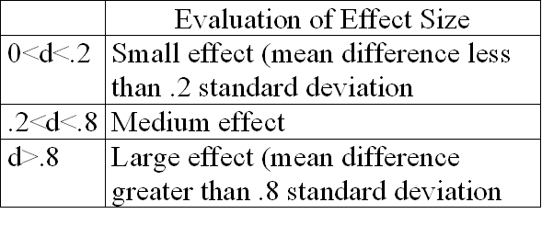
T-STATISTIC
EFFECT SIZE
Cohen’s d = |mean difference|/ sample standard deviation

Slide 26
T-STATISTIC
EFFECT SIZE
Cohen’s d = mean difference / sample standard deviation
For the previous example, Cohen’s d can be calculated as:
According to standards suggested by Cohen, this is a medium effect.

Slide 27
T-STATISTIC
Reporting the results of a t-test
In this study, it was predicted that the average test score of children from low SES families is not different from that of the population. A one-sample t-test was used to test this hypothesis, and indicates that there is no significant difference in the average test scores between children in general and those from low SES families (t (15)=-2.0, p <.05, d = .5).

Slide 28
T-STATISTIC
Example 2. A psychologist has prepared an “Optimism Test” that is administered to graduating college seniors. The test measures how each graduating class feel about its future. Last year’s class had a mean score of μ = 15. A sample of n = 9 seniors from this year’s class was selected and tested. Psychologist is interested in whether this year’s class has a different level of optimism than last year’s class?

Slide 29
T-STATISTIC
STEP 1: State the hypotheses
The null hypothesis H₀: μ = 15
The alternative hypothesis H₁: μ ≠ 15

Slide 30
T-STATISTIC
STEP 2: Set the criteria for the decision
We will use t-test rather than z, because σ is unknown.
df = n – 1 = 9 – 1 = 8 For a two-tailed test with α = .05 and df = 8, the critical t-values are ± 2.306.

Slide 31
T-STATISTIC
STEP 3: Collect data and compute test statistic
Sample data: 7, 12, 11, 15, 7, 8, 15, 9, 6
For the t formula, we need to compute sample mean and estimated standard error

Slide 32
T-STATISTIC
STEP 3: Collect data and compute test statistic

Slide 33
T-STATISTIC
STEP 4: Make a decision
The calculated t statistic (-4.39) is smaller than the critical t value (-2.306). Thus, we reject the null hypothesis and conclude that there is a significant difference in the level of optimism between this year’s and last year’s graduating classes, t (8) = - 4.39, p < .05, two-tailed. The effect size was large, d = 1.46.

Slide 34
T-STATISTIC
ASSUMPTIONS OF THE t TEST
Random sampling
Independent observation
Normality – the population sampled must be normal

